Slide 1
การท่องเที่ยวเชิงสุขภาพ (Wellness Tourism) : โอกาสการฟื้นตัวการท่องเที่ยวของไทย เภสัชกร อภิชัย เจียรอดิศักดิ์

Slide 3
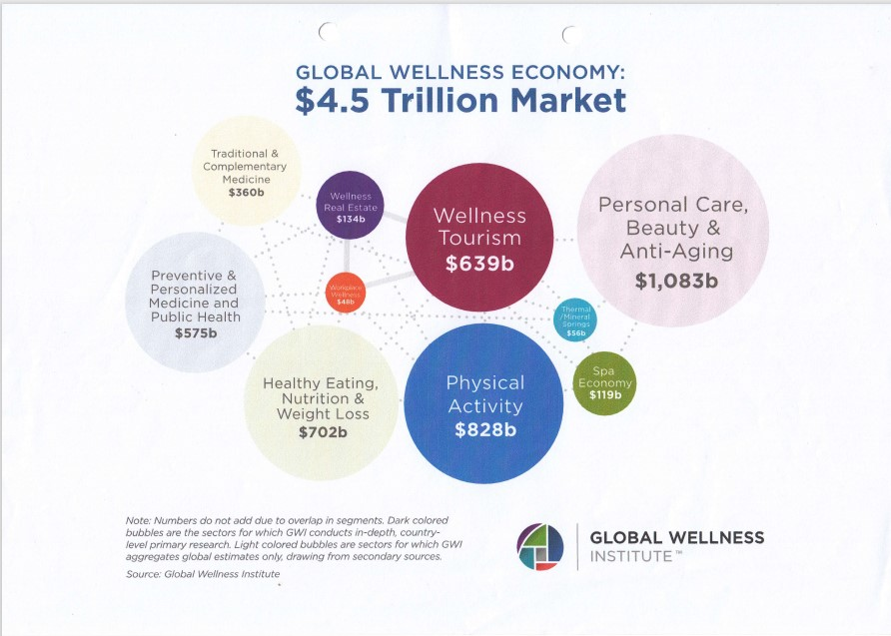

Slide 8
การท่องเที่ยวเชิงส่งเสริมสุขภาพของไทยจัดได้ว่า มีความพร้อมในระดับหนึ่ง จากการสนับสนุนของภาครัฐและภาคเอกชน ประเทศไทยมีโอกาสและความพร้อมที่จะพัฒนาการท่องเที่ยวเชิงส่งเสริมสุขภาพ ด้วยปัจจัยสนับสนุนหลัก ได้แก่

Slide 16
Beyond wellness tourism, the key sectors and economic impacts highlighted by the GWI include: (i) personal care, beauty, and anti-aging ($1,083 billion); (ii) healthy eating, nutrition, and weight loss ($702 billion); (iii) fitness and mind-body ($595 billion); (iv) preventive and personalized medicine and public health ($575 billion); (v) traditional and complementary medicine ($360 billion); (vi) wellness lifestyle real estate ($134 billion); (vii) spa economy ($119 billion); (viii) thermal/mineral springs ($56 billion); and (ix) workplace wellness ($48 billion)

Slide 17
Diversity and Drivers of Wellness Tourism Offers
The wellness offers of Virtuoso, an international network of 1,000 travel agency partners and 20,000 travel advisors in 50 countries, illustrate how wellness permeates a wide range of travel and tourism segments. Here are a few “wellness tourism” examples from their network:

Slide 18
Diversity and Drivers of Wellness Tourism Offers : (i) “organic spa cuisine” where guests pick their own fresh vegetables at the Golden Door Resort in California and then can choose spa treatments, hiking and walking trails, yoga, and other experiences; (ii) “signature experiences” at resorts such as the Indian wellness resort, Ananda in the Himalayas, which emphasizes meditation programs and yoga sessions to “unleash psychic energy and focus on breathing;

Slide 19
Diversity and Drivers of Wellness Tourism Offers : (iii) cruises with wellness options such as Regent’s Seven Seas Explorer, which offers yoga on deck, and Uniworld’s river cruises which offer onshore hiking and cycling and onboard wellness instructors; (iv) green space visits at airports, such as at Chicago’s O’Hare, Amsterdam, Dubai, and Singapore; and (v) nature-based physical activities that include white water rafting, zip-lining, and cycling.

Slide 20
ASIA’S WELLNESS TOURISM MARKET
The popularity of wellness tourism in these countries is
not surprising since, historically, these societies have emphasized mind-body connections, such as
traditional medicine in the PRC and the ROK,
tai chi in the PRC,
Hindu meditation and
- Ayurveda in India, and the deep spiritualism and oneness with nature of Buddhism.

Slide 21
Other countries in Asia and Pacific that include tourism in their national tourism strategies are Bhutan and the Maldives

Slide 23
Thailand is one of Southeast Asia’s largest and fastest -growing tourism destinations. In 2018 alone, international arrivals grew 7.3% to more than 38 million, earning it a ranking of the ninth most visited country. In fact, the country’s international arrivals grew faster than tourism globally, which averaged 5.6% in 2018.

Slide 24
STRATEGIC RECOMMENDATIONS
Wellness tourism has proved to be an important driver of economic growth and employment for tourism and national economies overall.

Slide 25
Immediate Actions 1.Public information campaigns. Wellness tourism is a valuable sector for destinations. As mentioned above, wellness travelers spend on average about 58% more than other types of travelers.

Slide 26
The “Krabi We Care” project strengthens the wellness tourism offer there by demonstrating community-wide cooperation to prevent COVID-19. The project is part of the local tourist office and industry efforts to promote responsible tourism and “encourage [e] the exchange of ideas between the locals, tourists and tourism operators on how to promote the concept both locally and to domestic and international tourists.” Wellness tourism is at the heart of their responsible tourism work

Slide 27
Thailand’s main wellness tourism offers are based on spa resorts with the Tourism Authority of Thailand (TAT) promoting 41 spa and wellness resorts in the country. These resorts are especially known for offering traditional Thai massage, which is influenced by traditional medicine and is promoted by TAT for relieving physical and mental tension, as well as reducing migraines, sprains, bruises, anxiety, and improving flexibility

Slide 28
Thailand Tourism Awards 2021

Slide 29
2. Increase proactive marketing and promotion of wellness tourism destinations as a solution for strengthening efforts for health, hygiene, and well-being. Wellness tourism emphasizes sustainable activities that strengthen health, hygiene, and well-being,

Slide 30
Phuket Tourism Sandbox

Slide 33
INTERNATIONAL TRAVELERS TERMS & CONDITIONS

Slide 34
3. Financial relief. The governments of the PRC, Singapore, the ROK, and other countries are providing economic stimulus to help the industry survive the outbreak. Similar support should be considered for wellness tourism destinations that are impacted by COVID-19 so that they can survive……..

Slide 36
Thank you for your attention

